Slide 1
Steps to Create an Action Agenda What Can your Chapter Do?
A Four-Part Webinar Series for TASH Members
Part 2 – April 16th
Barb Trader and Jennifer Bertrand

Slide 2
Today’s Agenda
TASH values and implications for action
Gap analysis
Power analysis
Setting clear priorities and their importance
Define success – short term, mid-term and long-term

Slide 3
Quote of the Day!
“Change starts when someone sees the next step.” William Drayton

Slide 4
“There must exist a paradigm, a practical model for social change that includes an understanding of ways to transform consciousness that are linked to efforts to transform structures.” ― Bell Hooks, killing rage: Ending Racism

Slide 5
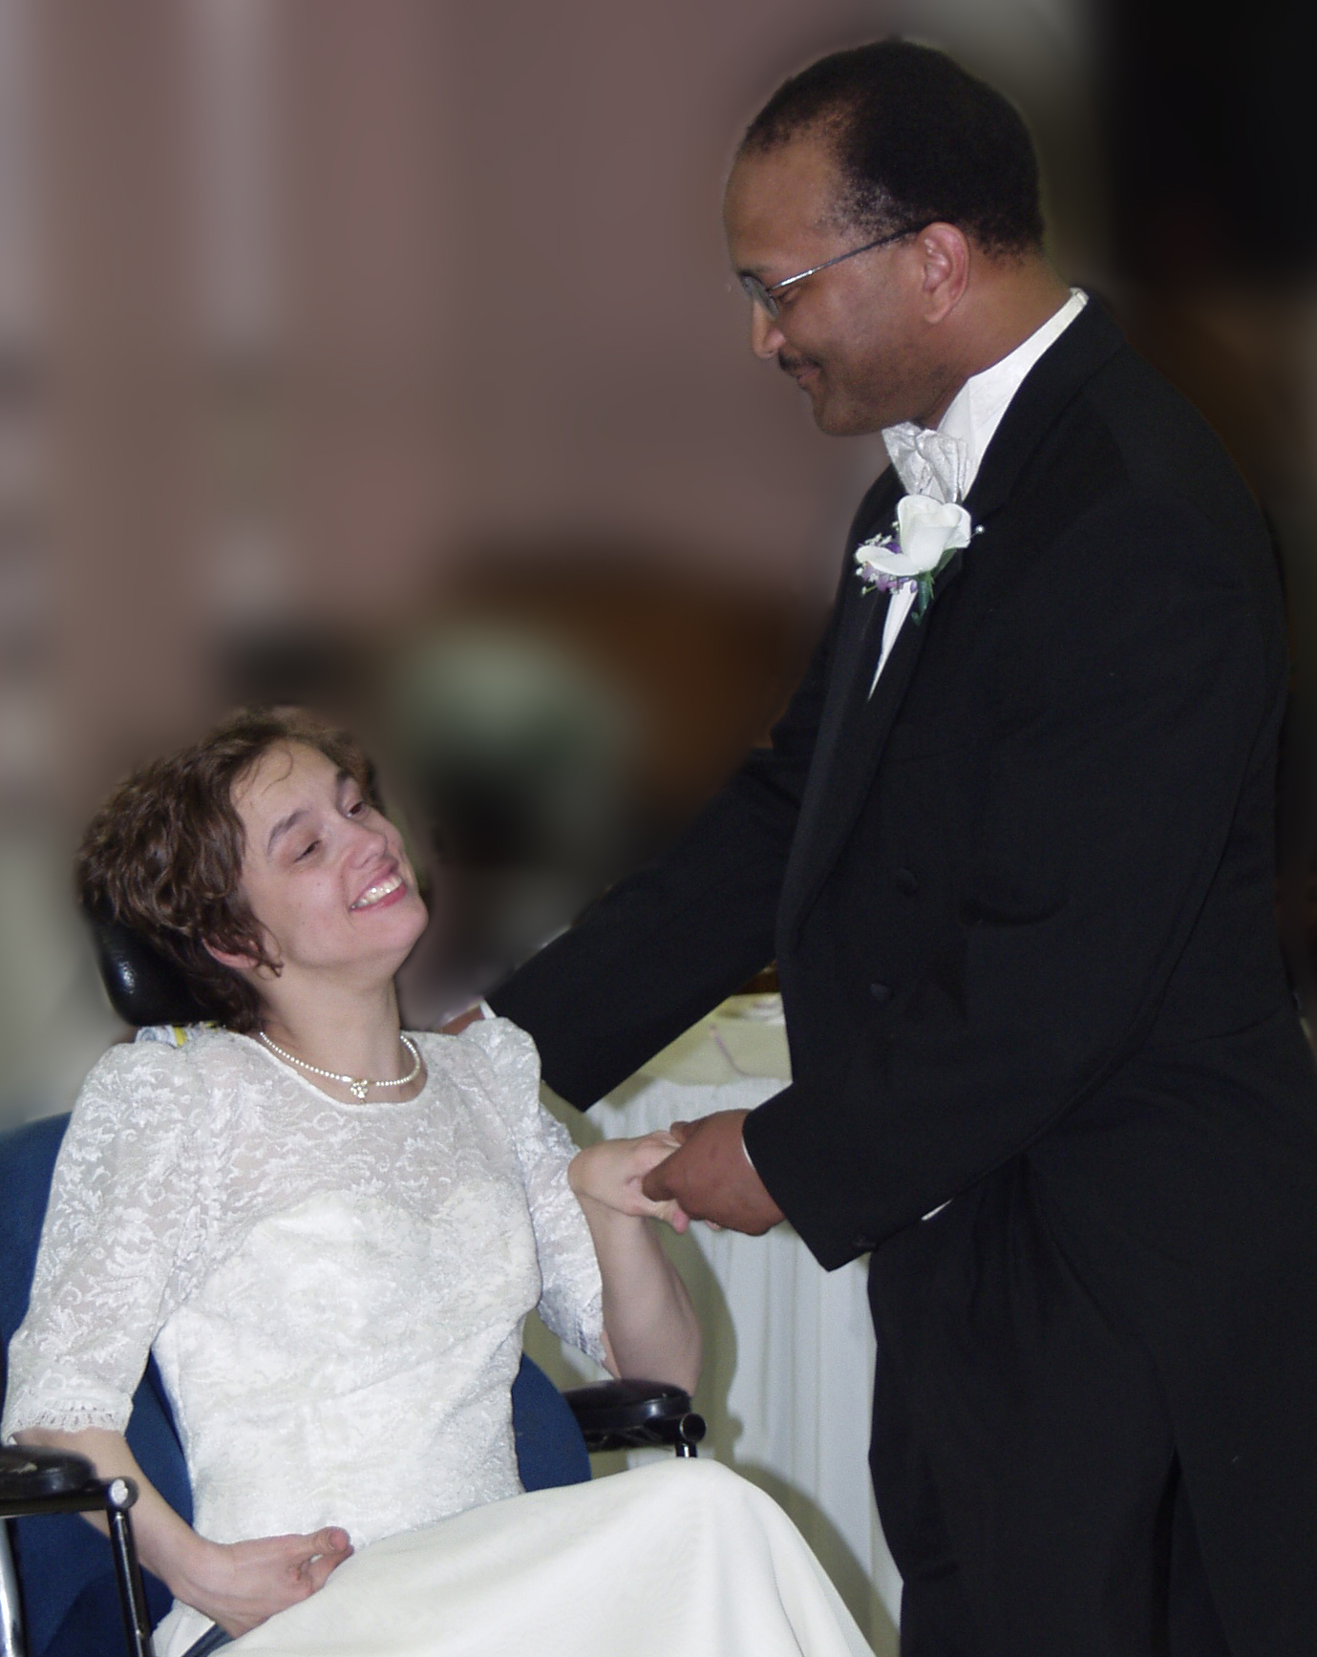
TASH Vision

Slide 6
TASH - Equity, Opportunity and Inclusion Since 1975 40 Years of Progressive Leadership
TASH has a vision of a world in which people with disabilities are fully participating members of their communities.
We envision communities in which no one is segregated and everyone belongs.

Slide 7
Gap Analysis
What do you want (TASH vision/values)?
For people with significant support needs to enjoy a quality of life similar to those available to all citizens
This means all people with disabilities must:
Be presumed to be competent to direct their own lives
Have a way to communicate.
Are fully included in their neighborhood schools.
Have protections against abuse, neglect, and aversive procedures.
Have the tools and opportunities to advocate on their own behalf.
Have a home, recreation, learning, and employment opportunities based on their personal vision of quality of life.
Have individualized supports that accommodate their functional needs.

Slide 8
Gap Analysis – Question 2
What is the current condition in your state?
Data
Day-to-day experiences
A policy framework and structures that supports what you want

Slide 9
Jennifer’s Story
The power of one, when multiplied by the power of ‘many’ & the unified momentum it can create!
The passage of Senate Bill 396

Slide 10
“Genuine equality means not treating everyone the same, but attending equally to everyone’s different needs.” ― Terry Eagleton, Why Marx Was Right

Slide 11
Power Analysis
For Each Issue You are Considering:
Who else cares about this issue and what is their position?
Local and state elected officials
Local and state agency staff
Business community
Communities of faith
People impacted by the issue as beneficiaries or family members
Professionals who work in the field
Who else?

Slide 12
Power Analysis
How do you find out their position?
In writing: websites, statements of principles, routed action alerts
In person meetings: discover self-interest *
*what does a person need to get for one’s own advantage?

Slide 13
Power Analysis
For Each Issue You are Considering:
Of those who care about this issue, what is their self-interest that drives their position?
Are there ways to appeal to that self-interest?

Slide 14
Power Analysis
For Each Issue You are Considering:
Of those who care about this issue, are there potential allies who share your position in part or in full?

Slide 15
The Importance of Priorities
Start small; learn; grow
Success keeps people interested
Gain credibility with each success
An overly ambitious agenda is overwhelming
Most advocates are volunteers and have to fit this in
Others?

Slide 16
Considerations for Setting Priorities
What are you best at?
What issue matters to most of your members?
What issue will be easiest to solve? (“low hanging fruit”)
Can you partner? Is someone else leading an issue with whom you agree with?
Can you lead? What issue is most natural for TASH leadership?
What issue will result in the biggest impact?

Slide 17
Defining Success
What is your long-term vision?
What can you get done this year?
Can you identify steps which you can celebrate along the way?
Debrief each activity – was it successful? What was good and what needs improvement? What will you do differently next time?
CELEBRATE each activity! You are learning even if you don’t “win” each battle.

Slide 18
Framework of Federal Protections
Levers for Advocates:
States interpret and determine administration of federal programs
States make plans and set priorities
States are expected to involve stakeholders
States determine enforcement mechanisms
Data
Evidence-based and promising practices

Slide 19
“Change starts when someone sees the next step.” William Drayton

Slide 20
What’s Happening in YOUR State?
Inclusion of students with disabilities www.nces.gov
Accountability for students with disabilities
Transition practices
Use of discipline
Integrated employment: http://book.statedata.info/13/
Use of 14(c) Certificates
Life in the Community
Other? http://www2.ed.gov/fund/data/report/idea/partbspap/allyears.html

Slide 21
Excessive Segregation in Schools
Roughly 5% of students with severe disability labels (autism, multiple disability, MR) are in inclusive classrooms -- meaning 95% of these students are excluded (www.nces.gov )

Slide 22
Discipline
Students with disabilities served by IDEA are more than twice as likely to receive one or more out-of-school suspensions as students without disabilities.
Students with disabilities represent a quarter of the students who are referred to law enforcement or subjected to school related arrests, while representing just 12% of the student population.
Students with disabilities represent 75% of students restrained
https://www2.ed.gov/about/offices/list/ocr/docs/crdc-discipline-snapshot.pdf

Slide 23
Excessive Segregation in Adult Life
87% of waiver funding goes to all-day facility-based work and day services
13% of waiver funding goes to all-day integrated employment and support services
http://book.statedata.info/13/

Slide 24
It’s Local!
Individual Advocacy
One Person
Systems Advocacy
One system/ committed leader
Public Advocate
Public commitment to improved lives

Slide 25
“If you can do nothing else, do whatever is in your power to make the people in your life feel completely unashamed of who they are.” ― Sam Killermann

Slide 26
It’s Local!
Use the three strategies of public advocacy
Educate
Legislate
Litigate

Slide 27
It’s Local!
Use the three legs of the advocacy stool –
Decision makers
Grassroots
Media – invite local papers to cover inclusive schools and why they work!!

Slide 29
Tip of the Week
Be PRINCIPLED!
TASH Resolutions: http://tash.org/advocacy-issues/

Slide 30
Barb Trader, Executive Director
btrader@tash.org
Become a Member
http://tash.org/join/
Donations and Inquiries
2013 H Street NW, Suite 715
Washington, DC 20006
Main Info Line: 202-540-9020
info@tash.org

Slide 31
Follow TASH's discussions & activity on Twitter and Facebook! Check out the latest news on our blog: TASH Blog. Located in New England or near North Carolina? Join us!

