Slide 1
Developing Strategy: Powerful Tools for Making Change
A Four-Part Webinar Series for TASH Members
Part 3 – April 23rd
Barb Trader and Tauna Szymanski

Slide 2
Today’s Agenda
Understand the difference between the levels of change
Know how to construct a set of principles and non-negotiables
Learn how to identify the state and local levers for change
Learn the key strategies and activities for action

Slide 3
Quote of the Day!
“The key to change …. Is to let go of fear.”
Roseann Cash

Slide 4
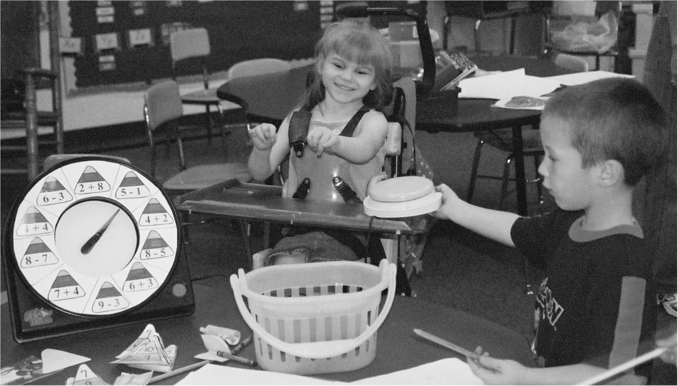
TASH Vision

Slide 5
TASH - Equity, Opportunity and Inclusion Since 1975 40 Years of Progressive Leadership
TASH has a vision of a world in which people with disabilities are fully participating members of their communities.
We envision communities in which no one is segregated and everyone belongs.

Slide 6
40 Year of Progress
Brown vs. Board of Ed – 1954 – Separate is not Equal!
Section 504, Rehab Act – 1973 – Physical and programmatic accessibility
IDEA – 1975 – Access, LRE
Katie Beckett Waiver – 1982 – Support at Home
ADA – 1990 – Integration Mandate
WIA – 1997 – Presumption of Employability

Slide 7
40 Year of Progress
Olmstead Decision – 1999 – Community Integration for Everyone!
ESEA – 2000 – “All Children Can Learn!” – Accountability for ALL Students
HCBS Waiver Rule – 2014 – No longer funds “Settings that Isolate” for residential, work and non-work
WIOA – 2014 – Transition to Integrated Employment
Executive Order -- $10.15 Minimum Wage for Federal Contractors

Slide 8
Framework of Federal Protections
Levers for Advocates:
States interpret and determine administration of federal programs
States make plans and set priorities
States are expected to involve stakeholders
States determine enforcement mechanisms
Data
Evidence-based and promising practices

Slide 9
Levels of Change
Individual Advocacy
One Person
Systems Advocacy
One system/ committed leader
Public Advocacy
Public commitment to improved lives

Slide 10
Tauna’s Story
Started Arlington Inclusion Task Force in Virginia last June
Inspiration: IEP for kindergarten (“we don’t do inclusion”)
Systems change effort
Focused on School Board and senior district administration (top down)
Parallel educational effort among teachers and parents (bottom up)

Slide 11
Tauna’s Story
What we’ve done so far
Lessons Learned
Several committed individuals
Importance of networks (email listserves, Facebook, Twitter), including a SEPTA
Being responsive, following up
Keeping perspective: multi-year effort; in it for the long haul
Working cooperatively with district as much as possible

Slide 12
“Our problems stem from our acceptance of this filthy, rotten system.” ― Dorothy Day

Slide 13
What’s Happening in YOUR State?
Inclusion of students with disabilities www.nces.gov
Accountability for students with disabilities
Transition practices
Use of discipline
Integrated employment: http://book.statedata.info/13/
Use of 14(c) Certificates
Life in the Community
Other? http://www2.ed.gov/fund/data/report/idea/partbspap/allyears.html

Slide 15
What do you Want?
What is not open to negotiation or discussion (Non-negotiables)?
Anything in opposition to principles
Be clear before you begin – what you are and are not willing to negotiate on
Ask for ALL you want, leave compromise for later
Make SURE there are points you can compromise on!

Slide 16
Clarity on Position: Principles and Non-Negotiables
http://www.ncwd-youth.info/assets/framework/silverstein_framework.pdf
Principle: a fundamental, primary or general truth from which others are derived

Slide 17
Example: SWIFT Policy Principles
Every student’s individual strengths, preferences and abilities are highly valued.
Every student receives a rigorous and quality education in order to become productive and contributing citizens.
Every adult in the school takes shared ownership for the success of every child.
Schools actively engage family and community partners.
Students are given meaningful opportunities to engage in their education.
Students are healthy: physically, socially and emotionally.

Slide 18
Principles for ESEA Reauthorization – signed by over 100 Civil Rights Groups
Each state adopts college and career-ready state standards and provides all students a fair and equal opportunity to meet these standards.
Annual, statewide assessments for all students that are aligned with, and measure each student’s progress toward meeting, the state’s college and career-ready standards.
Federal dollars are targeted to historically underserved students and schools.
State accountability systems expect and support all students to make enough progress every year so that they graduate from high school ready for college and career.
States and districts ensure that all Title I schools encourage and promote meaningful engagement and input of all parents/guardians.
States and LEAs improve data collection and reporting to parents and the public on student achievement and gap-closing, etc.
States implement and enforce the law.

Slide 19
Messages that Resonate
Responsive to self-interest!!
Equity
A chance to be a productive and responsible adult

Slide 20
Messaging: Equality vs. Equity

Slide 21
Messaging: What do we Want?
Safe, Inclusive Education
Integrated Employment (Real Jobs at Real Wages)
Independent Community Living & Economic Advancement

Slide 22
“The opposite of poverty is not wealth. In too many places, the opposite of poverty is justice.” ― Bryan Stevenson

Slide 23
Three Legs of the Advocacy Stool
Work with:
Decision makers
Grassroots
Media

Slide 24
Levers for Change
What is already happening that can be leveraged?
Federal law or regulation
State plan or application for funding
State performance and compliance determinations
Campaign promises of elected officials; party planks
Culture of community; self-interest of business community
Stated or understood self-interest of individuals in power positions
Lawsuit or settlement agreement/ court order
Other?

Slide 25
Strategies for Change
Use the three strategies of public advocacy and use your imagination!!
Educate
Legislate
Litigate

Slide 26
Educate – to inform people, raise awareness, train
Keep self interest of audience in mind!!
Decision-maker education – briefings, study tours, visits
Professional development – conferences, meetings, forums
Grassroots education – townhall meetings, issue briefs
Public education – traditional and social media
Other?

Slide 27
Legislate – to set new standards
State Implementation of Federal Law
State agency regulations and plans
State HCBS Waiver Transition Plan – adult residential and employment services
State Systemic Improvement Plan – results for students with disabilities
State Teacher Equity Plan – June 15th
New law/ revision of old law
Enable a new practice or activity
Bar barrier; harmful practice or activity
Establish funding sources

Slide 28
Litigate – to enforce existing standards and protections
Personal advocacy
Due process
Systems advocacy
Civil rights complaint process
Public advocacy
To seek a new/ revised interpretation of the law
Class actions
Sheltered workshops – Rhode Island and Oregon
Residential institutionalization – Virginia, Illinois, Georgia

Slide 29
Tip of the Week
Be OPPORTUNISTIC !!
http://www.nbcconnecticut.com/troubleshooters/LWRD-Seclusion-Rooms-Used-23000-Times-in-Connecticut-Schools-232611351.html

Slide 30
Barb Trader, Executive Director
btrader@tash.org
Become a Member
http://tash.org/get-involved/become-a-member/
Donations and Inquiries
2013 H. St, NW, Suite 715
Washington, DC 20006
Main Info Line: 202-540-9020
info@tash.org

Slide 31
Follow TASH's discussions & activity on Twitter and Facebook! Check out the latest news on our blog: TASH Blog. Located in New England or near North Carolina? Join us!

