Slide 1
Faith and Flourishing
TASH Conference
Nashville, TN

Slide 2
Definition of Flourish
of a person, animal, or other living organism; grow or develop in a healthy or vigorous way, especially as the result of a particularly favorable environment: "wild plants flourish on the banks of the lake“
synonyms: grow · thrive · prosper · do well · burgeon · increase · multiply · proliferate · spring up · shoot up · bloom · blossom · bear fruit · burst forth · run
all about growth and increase

Slide 3
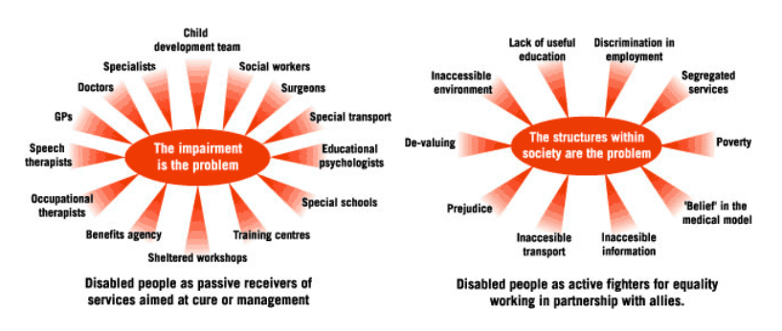
Check Your View and Disability Model
Medical Model - The disability is the problem.
Social Model - The barriers and structures with the society create the problem.
 | Group 1 | Group 2
Class 1 | 82 | 95
Class 2 | 76 | 88
Class 3 | 84 | 90

Slide 4
Check Your Heart or the Heart of the Congregation
Do you see those with disabilities with pity or with compassion?
Possessing great strengths and skill
Much to teach us (cultural humility)
Focused more on the person
Do you love those with disabilities like Jesus loves them?
Image Bearers
Fearfully and wonderfully made
Made with a purpose and a plan

Slide 5
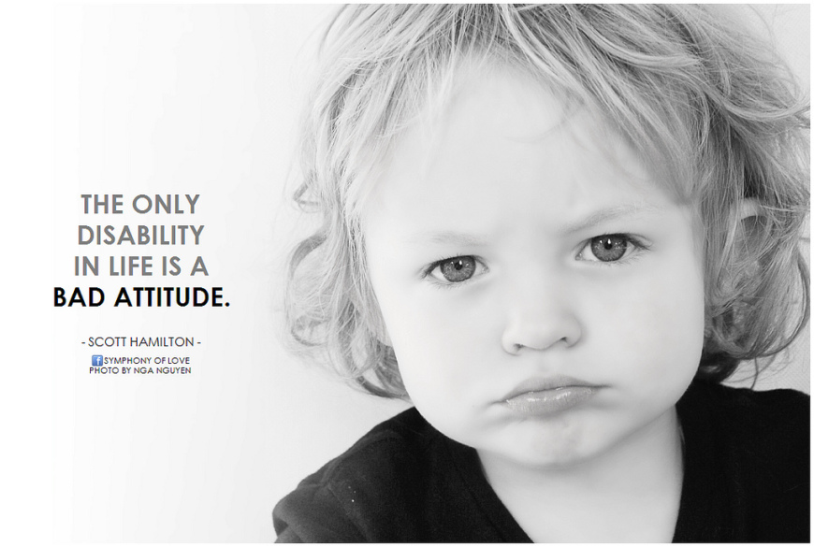

Slide 6
Common Church Path
Ministry to those with disabilities
Ministry with those with disabilities
Ministry by those with disabilities
View 1
View 2
View 3

Slide 7
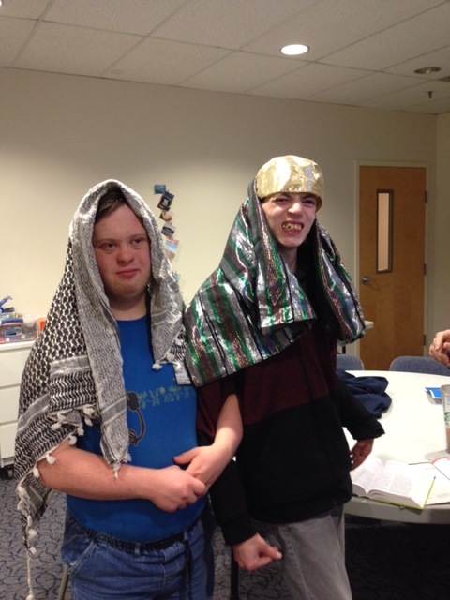
Focus on Each Individual, NOT on Programs
Intentionality
Investment
Flexibility
Creativity
“Once you’ve met one person with disabilities, you have met one person.”

Slide 8
Ingredients to Flourish
Need nourishment (spiritually, physically, relationally and emotionally)
A space of belonging and connections (voice and choice)
Opportunity to grow in knowledge, skills and participation (spiritual formation, ADL, social skills, independence, relationships)
Serving and blessing others (in and out of the church)

Slide 9
Not Us vs Them – It’s WE!
We all deserve to be able to choose our place of worship and what that participation will look like.
As our individual needs and preferences change, so do the spaces and places we connect.
We each have a faith community that supports us on this journey we call life.

